Slide 1


Slide 2

Conceptos
Cuando hay big data?
2
Bases de Datos NoSQL
3
Categorias y ejemplos
Diferencias con RDBMS
3 V’s
Teorema CAP
4
Que es Big Data?
1

Slide 3
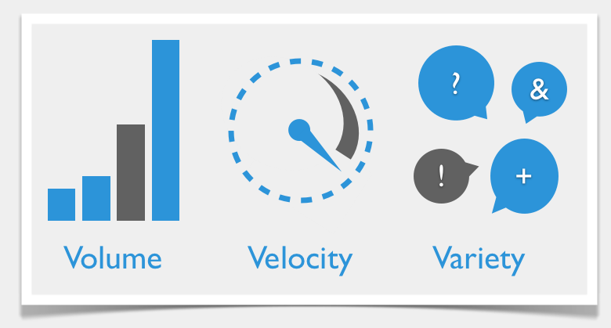
Big Data – 3 V’s
Notes:
Que sirgnifica cada sigla
Volume refers to the amount of data, variety refers to the number of types ofdata and velocity refers to the speed of data processing.

Slide 4
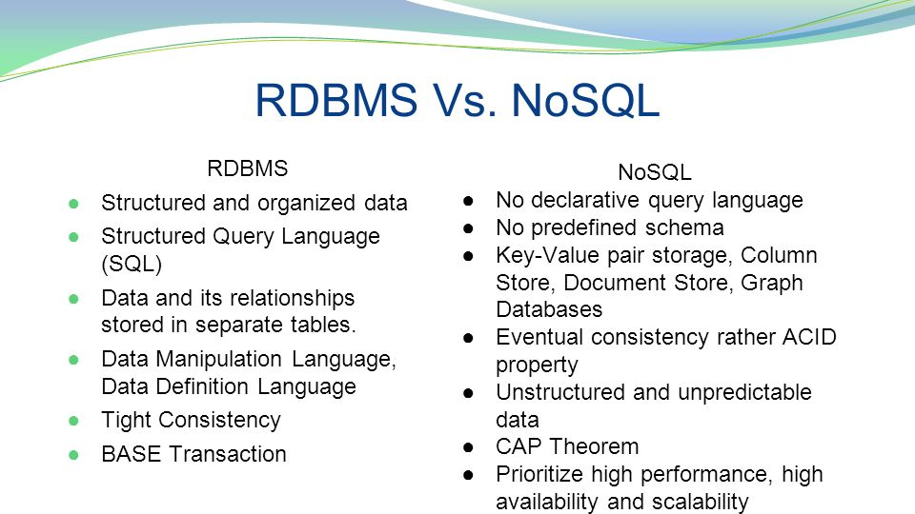
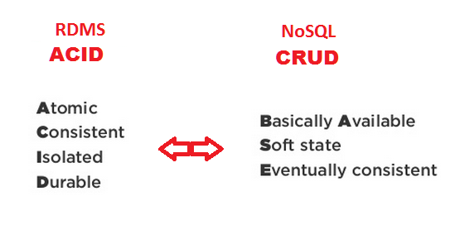
RDMS vs NoSQL
Notes:
- SQL databases are vertically scalable whereas the NoSQL databases are horizontally scalable. SQL databases are scaled by increasing the horse-power of the hardware. NoSQL databases are scaled by increasing the databases servers in the pool of resources to reduce the load.
SQL: It sticks to ACID principles (atomicity, consistency, isolation, durability), thus guaranteeing stability, security, and predictability both of the entire database and every transaction in particular.
NoSQL: It has been primarily developed to address the scalability problem characteristic of SQL. As a result, it is schema-free and built on distributed systems, which makes it easy to scale and shard.
However, these benefits come at the cost of relaxing ACID principles: instead of keeping all four parameters consistent throughout every transaction, NoSQL uses the principle of eventual consistency. This means that if there are no new updates for a particular data item for a certain period of time, eventually all accesses to it will return the last updated value. That’s why such systems are usually described as providing BASE guarantees (Basically Available, Soft state, Eventual consistency) — as opposed to ACID.
---
Atomic: Everything in a transaction succeeds or the entire transaction is rolled back.
Consistent: A transaction cannot leave the database in an inconsistent state.
Isolated: Transactions cannot interfere with each other.
Durable: Completed transactions persist, even when servers restart etc.
---
Basically available could refer to the perceived availability of the data. If a single node fails, part of the data won't be available, but the entire data layer stays operational.
Update: deducing from Mau's answer, could it mean the entire data layer is always accepting new data, i.e. there are no locking scenarios that prevent data from being inserted immediately?
Soft state: All I could find was the concept of data needing a period refresh. Without a refresh, the data will expire or be deleted.
Automatic deletion of data in a database seems strange to me.
Expired or stale data makes more sense. But this concept would apply to any type of redundant data storage, not just NoSQL. Does it describe something else then?
Eventual consistency means that updates will eventually ripple through to all servers, given enough time.
"eventual consistency" in which database changes are propagated to all nodes "eventually" (typically within milliseconds) so queries for data might not return updated data immediately or might result in reading data that is not accurate, a problem known as stale reads
--
Basically available indicates that the system it is mostly available but the servers might go down for various reasons
Soft state indicates that the state of the system may change over time, even without input. This is because of the eventual consistency model.
Eventual consistency indicates that the system will become consistent over time, given that the system doesn't receive input during that time.

Slide 5
When to use each
REASONS TO USE A SQL DATABASE
REASONS TO USE A NOSQL DATABASE
You need to ensure ACID compliancy (Atomicity, Consistency, Isolation, Durability).
ACID compliancy reduces anomalies and protects the integrity of your database by prescribing exactly how transactions interact with the database.
Your data is structured and unchanging
Storing large volumes of data that often have little to no structure.
Making the most of cloud computing and storage. Cloud-based storage is an excellent cost-saving solution, but requires data to be easily spread across multiple servers to scale up. Using commodity (affordable, smaller) hardware on-site or in the cloud saves you the hassle of additional software
Rapid development.

Slide 6
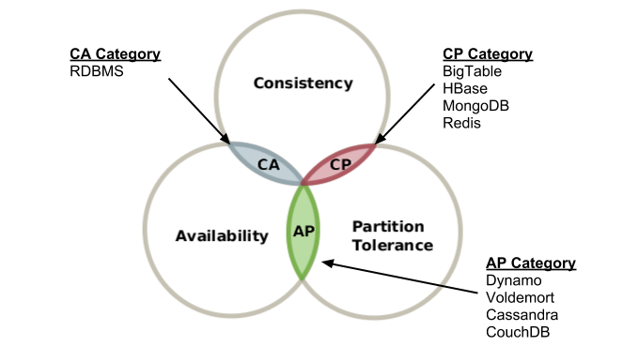
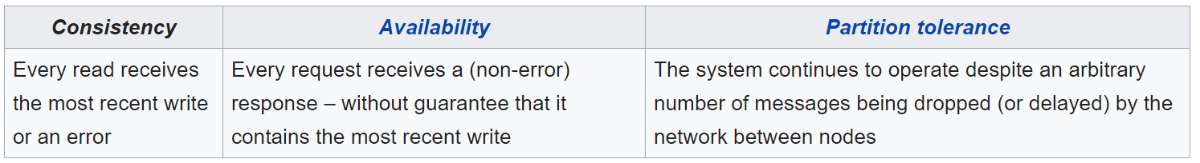
Big Data – Teorema CAP
Notes:
In other words, the CAP theorem states that in the presence of a network partition, one has to choose between consistency and availability.
No distributed system is safe from network failures, thus network partitioning generally has to be tolerated. In the presence of a partition, one is then left with two options: consistency or availability. When choosing consistency over availability, the system will return an error or a time-out if particular information cannot be guaranteed to be up to date due to network partitioning. When choosing availability over consistency, the system will always process the query and try to return the most recent available version of the information, even if it cannot guarantee it is up to date due to network partitioning.
Que bd hay en cada vertice

Slide 7
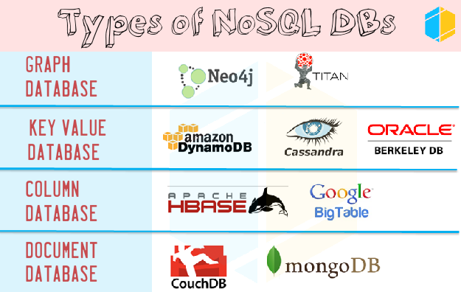
Big Data - NoSQL
Notes:
Diferencias – pros / contras / casos uso de cada una + ejemplos
Key-value model—the least complex NoSQL option, which stores data in a schema-less way that consists of indexed keys and values. Examples: Cassandra, Azure, LevelDB, and Riak.
Column store—or, wide-column store, which stores data tables as columns rather than rows. It’s more than just an inverted table—sectioning out columns allows for excellent scalability and high performance. Examples: HBase, BigTable, HyperTable.
Document database—taking the key-value concept and adding more complexity, each document in this type of database has its own data, and its own unique key, which is used to retrieve it. It’s a great option for storing, retrieving and managing data that’s document-oriented but still somewhat structured. Examples: MongoDB, CouchDB.
Graph database—have data that’s interconnected and best represented as a graph? This method is capable of lots of complexity. Examples: Polyglot, Neo4J.

Slide 8
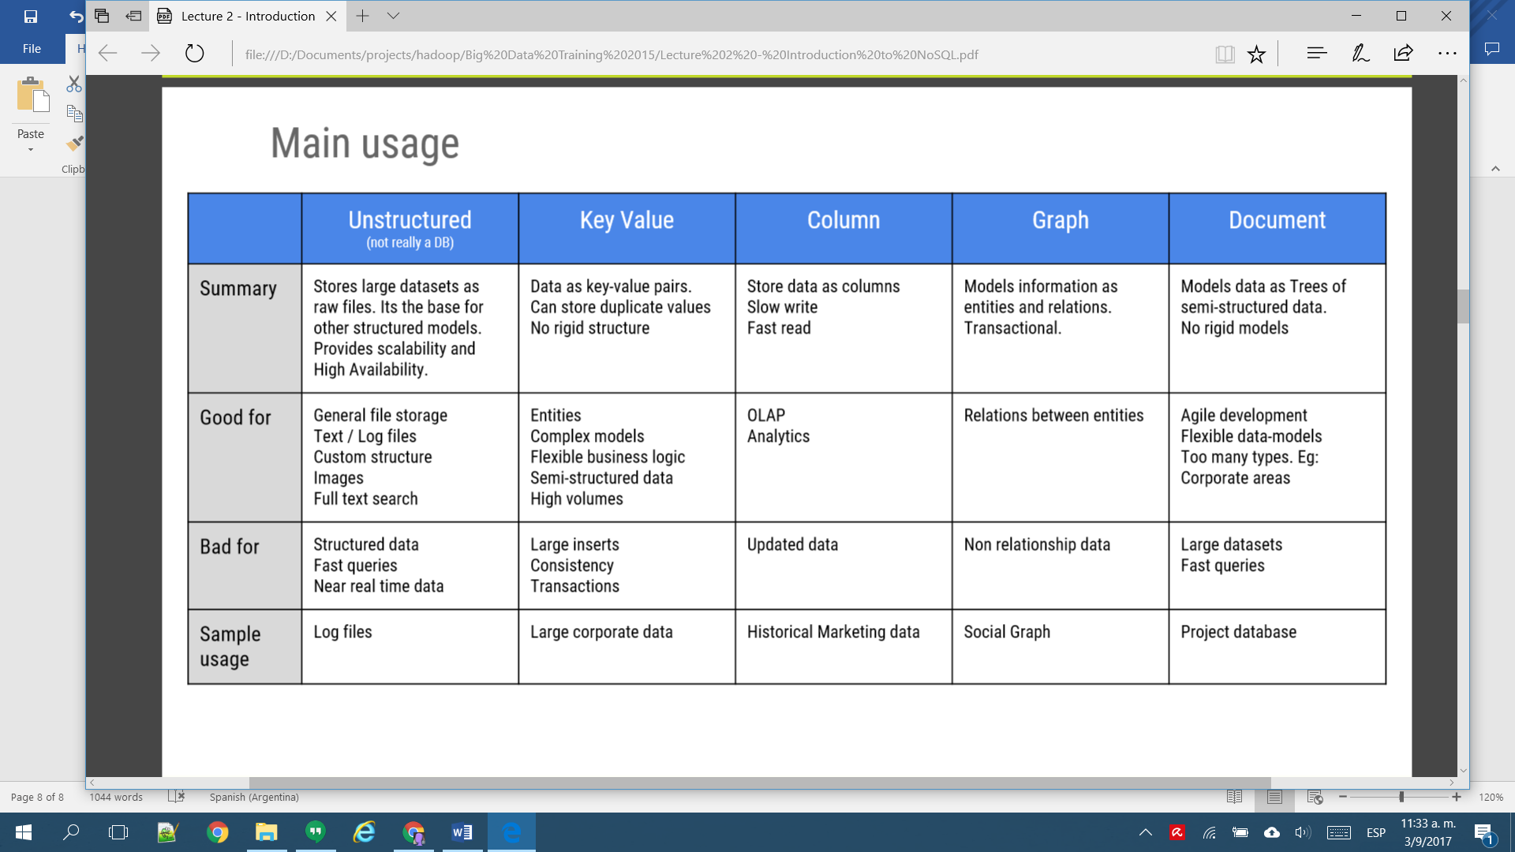
NoSQL categories

Slide 9
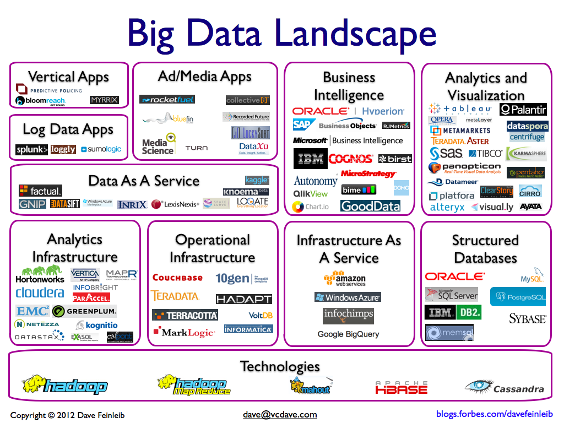

Slide 10

Apache Hadoop

Slide 11

Apache Hadoop
Que es / Casos de uso
Caracteristicas
Componentes
Landscape
Diferencias Hadoop 1 vs Hadoop 2
Cuando no usar Hadoop
Notes:
Apache Hadoop es un framework de software que soporta aplicaciones distribuidas bajo una licencia libre.¹​ Permite a las aplicaciones trabajar con miles de nodos y petabytes de datos. Hadoop se inspiró en los documentos Google para MapReduce y Google File System (GFS).
• Alta escalabilidad • Procesamiento paralelo • Baja latencia • Datos no estructurados y estructurados • NoSQL
Tecnología altamente escalable: Un clúster de Hadoop puede crecer simplemente añadiendo nuevos nodos. No es necesario hacer ajustes que modifiquen la estructura incicial. Por lo tanto, nos permite un crecimiento fácil, sin estar atados a las características iniciales del diseño, haciendo uso de decenas de servidores de abajo costo que, a diferencia de la base de datos relacional, no puede escalar. Gracias al procesamiento distribuido de MapReduce, los archivos se dividen en bloques de forma sencilla.
Almacenamiento a bajo costo: La informacion no se almacena de forma predefinida, en filas y columnas, como ocurre con las bases de datos tradicionales, sino que Hadoop asigna datos categorizados a través de miles de computadoras baratas, y ello supone un gran ahorro. Sólo así se convierte en factible. De otro modo, no podríamos trabajar con grandes volúmenes de datos, pues el costo sería altísimo, inasumible para la gran mayoría de las empresas.
Flexibilidad: Al incrementar el número de nodos del sistema también ganamos en capacidad de almacenamiento y procesamiento. A su vez, es posible agregar o acceder a nuevas ydiferentes fuentes de datos (estructurados, semiestructurados y no estructurados), al tiempo que existe la posibilidad de adaptar herramientas accesorias que funcionan en el entorno Hadoop y ayudan en el diseño de procesos, la integración o mejorar otros aspectos.
Velocidad: De poco nos servirán su bajo coste, escalabilidad y flexibilidad si el resultado no es razonablemente rápido. Afortunadamente, Hadoop también permite ejecutar procesamientos y realizar análisis muy rápidos.
Tolerante a fallos: Hadoop es una tecnología que facilita almacenar grandes volúmenes de información, lo que a su vez permite recuperar datos de forma segura. Si un equipo se cae, siempre hay otra copia disponible, con lo que es posible la recuperación de datos en caso de producirse fallos.
Hadoop Architecture distributes data across the cluster nodes by splitting it into small blocks (64 MB or 128 MB depending upon the configurations). Every node tries to work on individual block stored locally. Hence no data transfer is required during the processing most of the time.
Every time when Hadoop process the data, each node connects to other node as much less as possible. So most of the time node only deals with the data which is stored locally. This concept is known as “Data Locality”.
As we know data is distributed across the nodes, so in order to increase data availability each block of the data is replicated (as per the configuration) over different nodes. This method would help Hadoop to handle partial failures in the cluster.
Whenever MapReduce job (consist to typically two tasks Map Task and Reduce Task) is executed, Map tasks are executed on individual data blocks on each node (in most of the cases) and leverage “Data Locality”. This is how multiple nodes process data in parallel manner. It makes processing faster than traditional distributed systems. I’ll Explain you MapReduce in my upcoming posts.
If any node fails in between, the master will detect this failure and assign the same task to another node where the replica of the same data block is available.
If any failed node restarts, it automatically joins back to the cluster and than after master can assign it a new task whenever is required.
In the execution process of any job, if master detects any task running slowly on any node compare to other nodes, it will allocate the same redundant task on other node to make overall execution faster. This process is known as “Speculative Execution“
The Hadoop jobs are written in a high level language like Java and Python, and the developer do not have any control over network programming or component level programming. You just have to focus on core logic other things would be taken care by Hadoop framework itself.

Slide 12
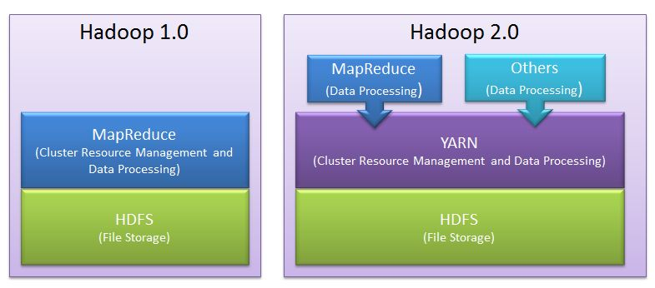
Hadoop

Slide 13
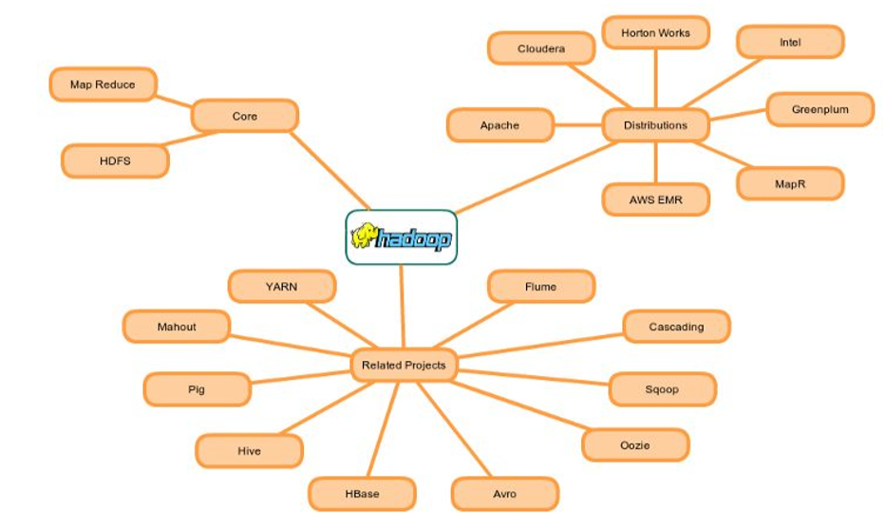

Slide 14
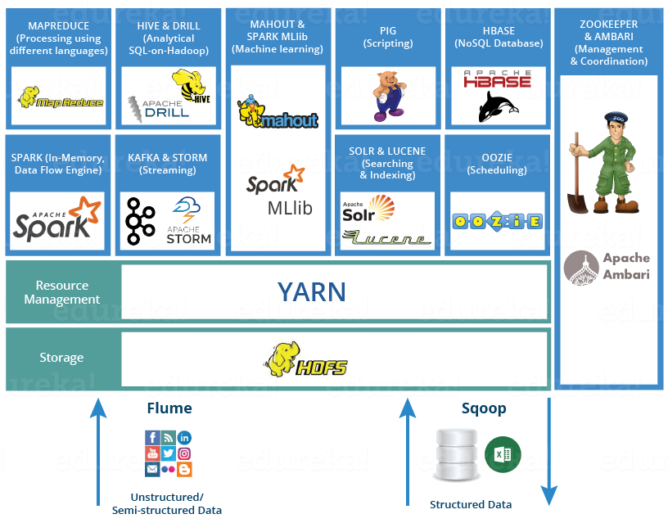
Hadoop Ecosystem

Slide 15
Hadoop1 | Hadoop2
Supports MapReduce (MR) processing model only. Does not support non-MR tools | Allows to work in MR as well as other distributed computing models like Spark, Hama, Giraph, Message Passing Interface) MPI & HBase coprocessors.
MR does both processing and cluster-resource management. | YARN (Yet Another Resource Negotiator) does cluster resource management and processing is done using different processing models.
Has limited scaling of nodes. Limited to 4000 nodes per cluster | Has better scalability. Scalable up to 10000 nodes per cluster
Works on concepts of slots – slots can run either a Map task or a Reduce task only. | Works on concepts of containers. Using containers can run generic tasks.
A single Namenode to manage the entire namespace. | Multiple Namenode servers manage multiple namespaces.
Has Single-Point-of-Failure (SPOF) – because of single Namenode- and in the case of Namenode failure, needs manual intervention to overcome. | Has to feature to overcome SPOF with a standby Namenode and in the case of Namenode failure, it is configured for automatic recovery.
MR API is compatible with Hadoop1x. A program written in Hadoop1 executes in Hadoop1x without any additional files. | MR API requires additional files for a program written in Hadoop1x to execute in Hadoop2x.
Has a limitation to serve as a platform for event processing, streaming and real-time operations. | Can serve as a platform for a wide variety of data analytics-possible to run event processing, streaming and real-time operations.
A Namenode failure affects the stack. | The Hadoop stack – Hive, Pig, HBase etc. are all equipped to handle Namenode failure.
Does not support Microsoft Windows | Added support for Microsoft windows
Notes:
Hadoop 2.x has some common Hadoop API which can easily be integrated with any third party applications to work with Hadoop
It has some new Java APIs and features in HDFS and MapReduce which are known as HDFS2 and MR2 respectively
New architecture has added the architectural features like HDFS High Availability and HDFS Federation
Hadoop 2.x not using Job Tracker and Task Tracker daemons for resource management now on-wards, it is using YARN (Yet Another Resource Negotiator) for Resource Management

Slide 16
Hadoop not good for
1. Low-latency Data Access
Applications that require real-time query, and low-latency access to data in tens of milliseconds will not work well with Hadoop.
Hadoop is not a substitute for a database. Database index records that will gains low-latency and fast response.
But if you really want to replace the database for real time needs, try HBase, which is a column-oriented database for random and real time read/write.
2. Structured Data
Hadoop is not fit for structured data with strong relationship. Hadoop works well for semi-structured and unstructured data. It stores data in files, doesn’t index them like RDBMS. Therefore, each ad hoc query for Hadoop is processed by MapReduce job which will bring the latency cost.
3. When data isn’t that big
How big the data is big enough for Hadoop? The answer is TB or PB. When your analytics data is only tens of GB, Hadoop is heavy. Don’t follow the fashion and use Hadoop, just follow your requirements.
4. Too many small files
When there are too many small files, the NameNode will hit its memory limit where the block map and the metadata are hosted. And to handle the NameNode bottleneck, Hadoop introduces HDFS Federation.
5. MapReduce may not the best choice
MapReduce is a simple programming model in parallel. But for MapReduce parallelism, you need to make sure each MR job and the data where the job runs on is independent from all the others. Every MR shouldn’t have dependencies.
But if you want to do some data sharing during MR, you can do like this:
- Iteration: run multiple MR jobs, with the output of one being the input of the next MR.
- Shared state information. But don’t share information in memory, since each MR job is run on single JVM.

Slide 17

Map Reduce
Notes:
MapReduce es un proceso batch, creado para el proceso distribuido de los datos. Permite de una forma simple, paralelizar trabajo sobre los grandes volúmenes de datos, como combinar web logs con los datos relacionales de una base de datos OLTP, de esta forma ver como los usuarios interactúan con el website.
El modelo de MapReduce simplifica el procesamiento en paralelo, abstrayéndonos de la complejidad que hay en los sistemas distribuidos. Básicamente las funciones Map transforman un conjunto de datos a un número de pares key/value. Cada uno de estos elementos se encontrará ordenado por su clave, y la función reduce es usada para combinar los valores (con la misma clave) en un mismo resultado.
Un programa en MapReduce, se suele conocer como Job, la ejecución de un Job empieza cuando el cliente manda la configuración de Job al JobTracker, esta configuración especifica las funciones Map, Combine (shuttle) y Reduce, además de la entrada y salida de los datos.

Slide 18
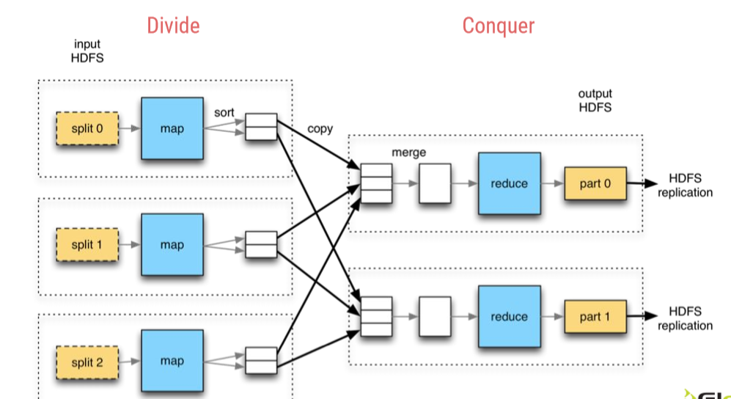
Notes:
Each of these tasks would run on individual blocks of the data
First mapper task would take each line of elements as an input and generates intermediate key value pairs
Each mapper task is executed on a single block of data
Than reducer task will take list of key value pairs for same keys, process the data and generates the final output
A phase called shuffle and sort will take place between mapper and reducer task will send the data to proper reducer tasks
Shuffle process maps the mapper output with the same key to the collection of values as a value
For example (key1, val1) and (key1, val2) will be converted to (key1, [val1, val2])
The mapper and reducer tasks would in parallel
The reducer tasks can start their word as soon as mapper tasks are completed

Slide 19

HDFS

Slide 20
Highly Distributed File System
HDFS
Que es?
Componentes
Namenode
Como funciona?
Arquitectura
Datanode
Componentes y funciones
Concepto bloque
Secondary Namenode
Problemas
SPOF → HDFS HA – Standby NN
NN RAM & blocks → HDFS Federation
Proceso
Write data
Read data

Slide 21
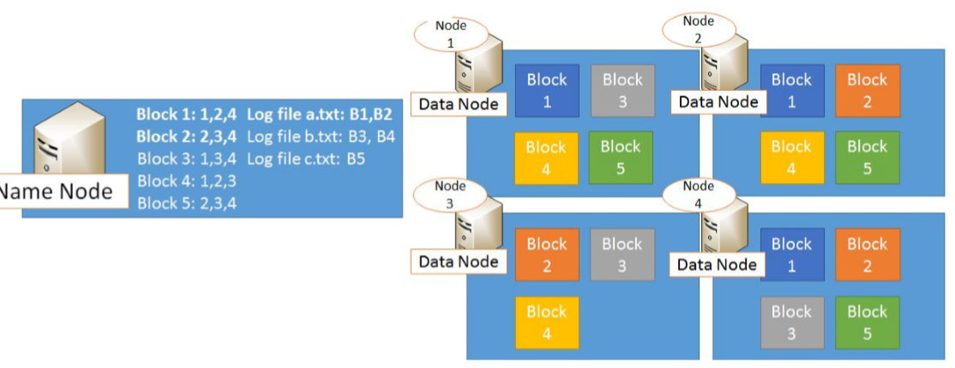
HDFS
Notes:
Single Point Of Failure: As per above description, HDFS has only one Name Node so if that process or machine goes down complete cluster goes down. That is why Name Node in Hadoop 1.x is considered to be a Single Point of Failure.
Blocks are the nothing but the smallest continuous location on your hard drive where data is stored. In general, in any of the File System, you store the data as a collection of blocks. Similarly, HDFS stores each file as blocks which are scattered throughout the Apache Hadoop cluster. The default size of each block is 128 MB in Apache Hadoop 2.x (64 MB in Apache Hadoop 1.x) which you can configure as per your requirement.
It is not necessary that in HDFS, each file is stored in exact multiple of the configured block size (128 MB, 256 MB etc.). Let’s take an example where I have a file “example.txt” of size 514 MB as shown in above figure. Suppose that we are using the default configuration of block size, which is 128 MB. Then, how many blocks will be created? 5, Right. The first four blocks will be of 128 MB. But, the last block will be of 2 MB size only.

Slide 22
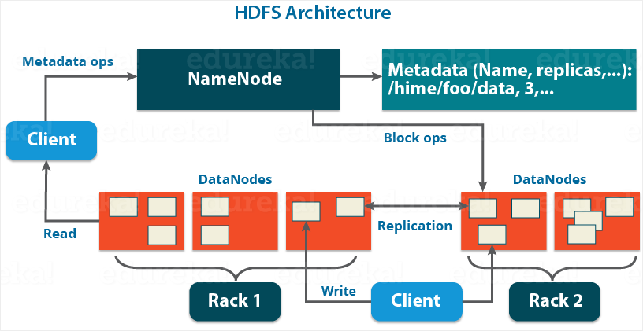
HDFS - Architecture
Notes:
Name Node
There is only single instance of this process runs on a cluster and that is on a master node
It is responsible for manage metadata about files distributed across the cluster
It manages information like location of file blocks across cluster and it’s permission
This process reads all the metadata from a file named fsimage and keeps it in memory
After this process is started, it updates metadata for newly added or removed files in RAM
It periodically writes the changes in one file called edits as edit logs
This process is a heart of HDFS, if it is down HDFS is not accessible any more
Secondary Name Node
For this also, only single instance of this process runs on a cluster
This process can run on a master node (for smaller clusters) or can run on a separate node (in larger clusters) depends on the size of the cluster
One misinterpretation from name is “This is a backup Name Node” but IT IS NOT!!!!!
It manages the metadata for the Name Node. In the sense, it reads the information written in edit logs (by Name Node) and creates an updated file of current cluster metadata
Than it transfers that file back to Name Node so that fsimage file can be updated
So, whenever Name Node daemon is restarted it can always find updated information in fsimage file
Data Node
There are many instances of this process running on various slave nodes(referred as Data nodes)
It is responsible for storing the individual file blocks on the slave nodes in Hadoop cluster
Based on the replication factor, a single block is replicated in multiple slave nodes(only if replication factor is > 1) to prevent the data loss
Whenever required, this process handles the access to a data block by communicating with Name Node
This process periodically sends heart bits to Name Node to make Name Node aware that slave process is running

Slide 23
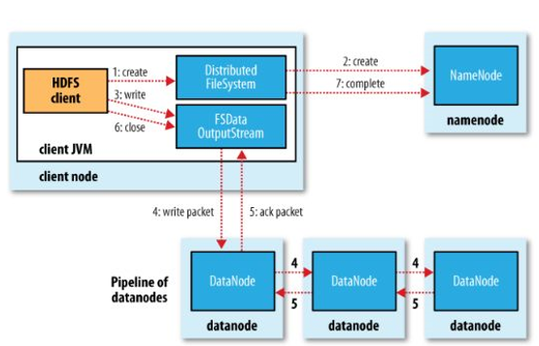
HDFS
Write data flow

Slide 24
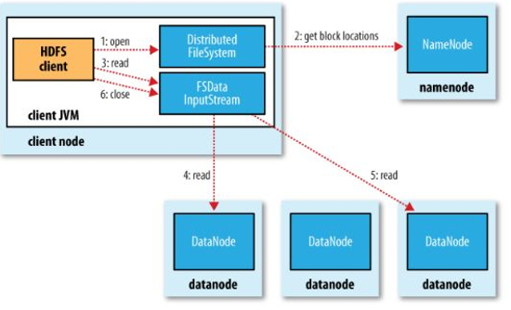
HDFS
Read data flow

Slide 25

Yarn

Slide 26
Yet Another Resource Manager
YARN
Que es?
Componentes
ResourceManager
Como funciona?
Arquitectura
Componentes y funciones
Concepto container
Problemas
Data Locality
NodeManager
ApplicationMaster
Scheduler
ApplicationManager
Proceso
Run job process
Yarn HA
Notes:
Resource Manager
This daemon process runs on master node (may run on the same machine as name node for smaller clusters)
It is responsible for getting job submitted from client and schedule it on cluster, monitoring running jobs on cluster and allocating proper resources on the slave node
It communicates with Node Manager daemon process on the slave node to track the resource utilization
It uses two other processes named Application Manager and Scheduler for MapReduce task and resource management
Scheduler
This daemon process resides on the Master Node (runs along with ResourceManager daemon )
Responsible for,
Scheduling the job execution as per submission request received by ResourceManager
Allocating resources to applications submitted to the cluster
Coordinating with ApplicationManager daemon and keeping track of resources of running applications
ApplicationManager
This daemon process resides on the Master Node (runs along with ResourceManager daemon )
Responsible for,
Helping Scheduler daemon to keeps track of running application by coordination
Accepting job submissions from client
Negotiating first container for executing application specific task with suitable ApplicationMaster on slave node
Node Manager
This daemon process runs on slave nodes (normally on HDFS Data node machines)
It is responsible for coordinating with Resource Manager for task scheduling and tracking the resource utilization on the slave node
It also reports the resource utilization back to the Resource Manager
It uses other daemon process like Application Master and Container for MapReduce task scheduling and execution on the slave node
ApplicationMaster
This daemon process runs on the slave node (along with the NodeManager daemon)
It is per application specific library works with NodeManager to execute the task
The instance of this daemon is per application, which means in case of multiple jobs submitted on cluster, it may have more than one instances of ApplicationMaster on slave nodes
Responsible for,
Negotiating suitable resource containers on slave node from ResourceManager
Working with one or multiple NodeManagers to monitor task execution on slave nodes
Container
It is considered to be a small unit of resources (like cpu, memory, disk) belong to the SlaveNode
Scheduler process running along with ResourceManager daemon allocates the resources as a container
At the beginning of a job execution with YARN, container allows ApplicationMaster process to make a use of some resources on any slave node on the cluster
Then ApplicationMaster manages the application execution across other containers on slave nodes of a YARN cluster

Slide 27
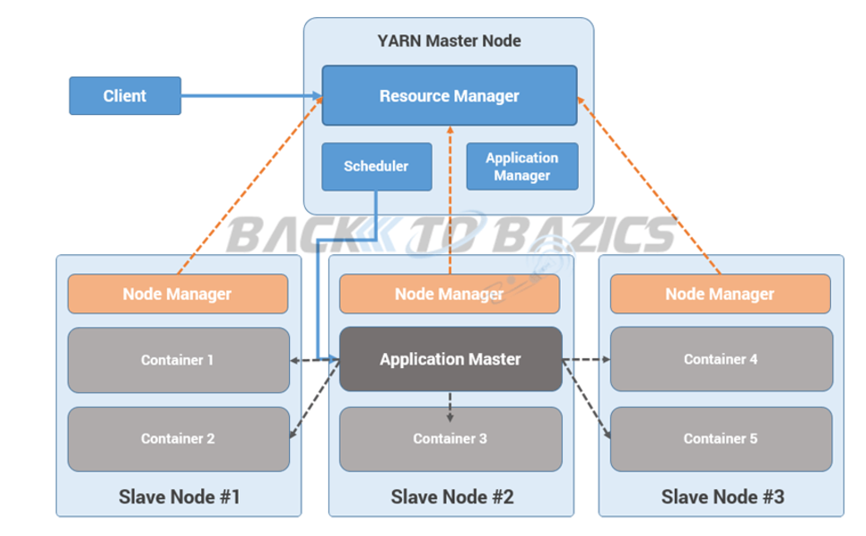
YARN
Run job process
Notes:
Step 1: Job/Application(which can be MapReduce, Java/Scala Application, DAG jobs like Apache Spark etc..) is submitted by the YARN client application to the ResourceManager daemon along with the command to start the ApplicationMaster on any container at NodeManager
Step 2: ApplicationManager process on Master Node validates the job submission request and hand it over to Scheduler process for resource allocation
Step 3: Scheduler process assigns a container for ApplicationMaster on one slave node
Step 4: NodeManager daemon starts the ApplicationMaster service within one of its container using the command mentioned in Step 1, hence ApplicationMaster is considered to be the first container of any application
Step 5: ApplicationMaster negotiates the other containers from ResourceManager by providing the details like location of data on slave nodes, required cpu, memory, cores etc..
Step 6: ReourceManager allocates the best suitable resources on slave nodes and responds to ApplicationMaster with node details and other details
Step 7: Then, ApplicationMaster send requests to NodeManagers on suggested slave nodes to start the containers
Step 8: ApplicationMaster than manages the resources of requested containers while job execution and notifies the ResourceManager when execution is completed
Step 9: NodeManagers periodically notify the ResourceManager with the current status of available resources on the node which information can be used by scheduler to schedule new application on the clusters
Step 10: In case of any failure of slave node ResourceManager will try to allocate new container on other best suitable node so that ApplicationMaster can complete the process using new container

Slide 28
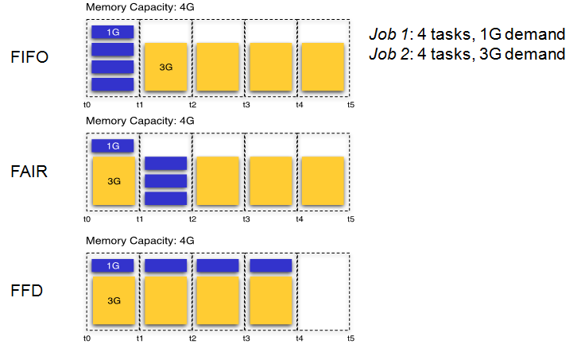
Schedulers
Notes:
Programación de tiempo[editar]
Por defecto Hadoop usa el método FIFO para programar la realización de trabajos desde una cola de trabajo. En la versión 0.19 el job scheduler (programador de trabajos) fue refactorizado fuera de Hadoop, lo cual añadió la habilidad de usar un programador alternativo.¹⁰​
Programador justo[editar]
El fair scheduler (programador justo o limpio) fue desarrollado por Facebook. El objetivo del programador es proporcionar rápida respuesta para trabajos pequeños y calidad de servicio (QOS, en sus siglas en inglés) para trabajos de producción. El fair scheduler se basa en 3 conceptos básicos:¹¹​
Los trabajos se agrupan en pools.
Cada pool tiene asignada una porción mínima garantizada.
El exceso de capacidad se distribuye entre trabajos.
Por defecto, los trabajos que están sin categorizar van a un pool por defecto. Las pools tienen que especificar el nº mínimo de slots de mapa, los reduce slots, y un límite en el número de trabajos ejecutándose.
Programador de capacidad[editar]
El programador de capacidad fue desarrollado por Yahoo. Soporta varias funciones similares a las del fair scheduler.¹²​
Los trabajos son presentados en las colas.
A las colas se le asigna una fracción de la capacidad total de recursos.
Los recursos libres se asignan a las colas más allá de su capacidad total.
Dentro de una cola, un trabajo con un alto nivel de prioridad tendrá acceso a los recursos de la cola.
No es posible la expropiación de recursos cuando se está ejecutando un trabajo.

Slide 29

Sqoop
Notes:
Apache Sqoop (“Sql-to-Hadoop”), es una herramienta diseñada para transferir de forma eficiente bulk data entre Hadoop y sistemas de almacenamiento con datos estructurados, como bases de datos relacionales. Algunas de sus características son:
Permite importar tablas individuales o bases de datos enteras a HDFS.
Genera clases Java que permiten interactuar con los datos importados.
Además, permite importar de las bases de datos SQL a Hive.

Slide 30
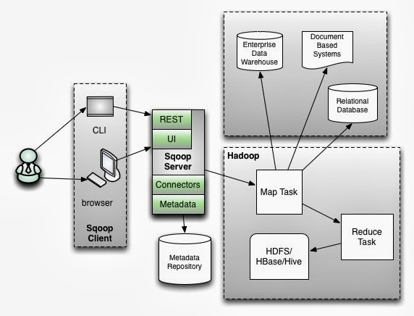
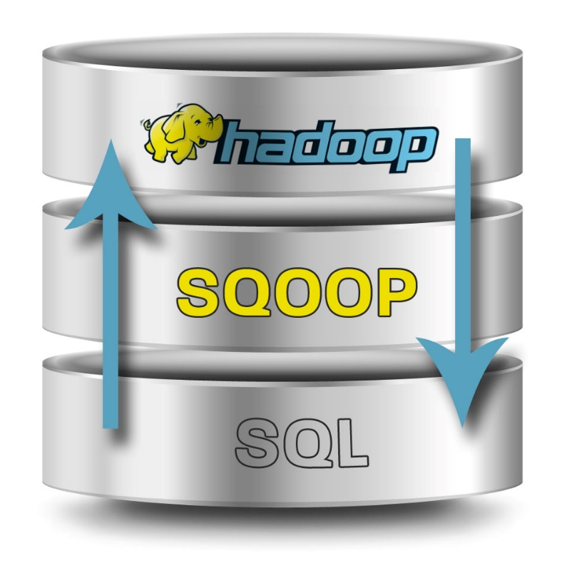
Sqoop

Slide 31
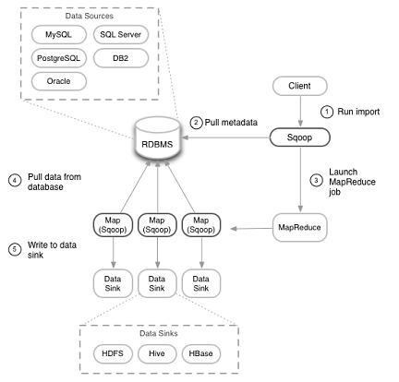
Sqoop
Import overview

Slide 32


Pig
Notes:
Apache Pig, inicialmente desarrollado por Yahoo, permite a los usuarios de Hadoop centrarse más en el análisis de los datos y menos en la creación de programas MapReduce. Para simplificar el análisis proporciona un lenguaje procedural de alto nivel. Su nombre viene de la siguiente analogía, al igual que los cerdos comen de todo, el lenguaje de programación Pig está pensado para poder trabajar en cualquier tipo de datos. Pig consta de dos componentes:
El lenguaje en si, llamado PigLatin.
El entorno de ejecución, donde los programas PigLatin se ejecutan.

Slide 33
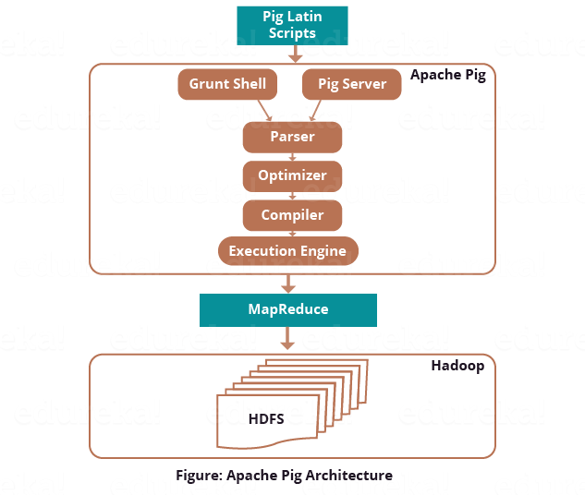
Pig

Slide 34

Hive
Notes:
Hive es un sistema de Data Warehouse para Hadoop que facilita el uso de la agregación de los datos, ad-hoc queries, y el análisis de grandes datasets almacenados en Hadoop. Hive proporciona métodos de consulta de los datos usando un lenguaje parecido al SQL, llamado HiveQL. Además permite de usar los tradicionales Map/Reduce cuando el rendimiento no es el correcto. Tiene interfaces JDBC/ODBC, por lo que empieza a funcionar su integración con herramientas de BI.

Slide 35
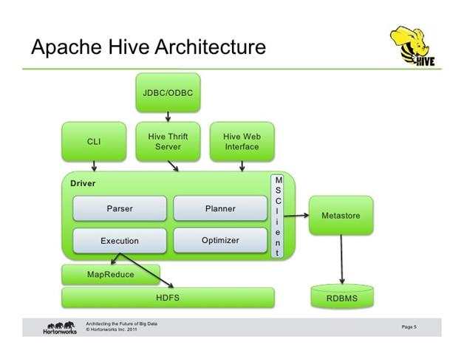
Hive

Slide 36
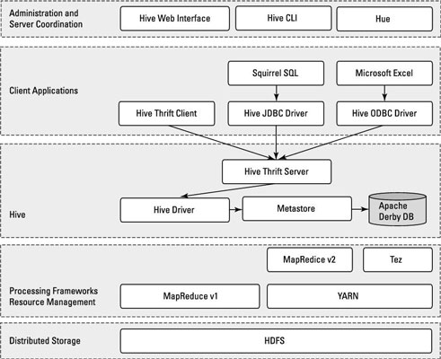
Hive

Slide 37

Spark

Slide 38
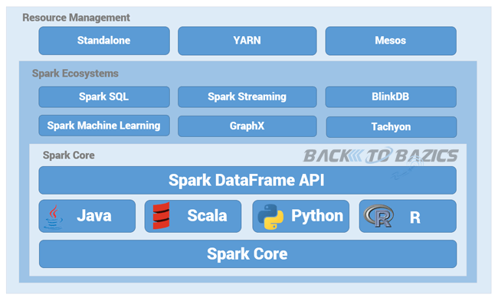
Spark

Slide 39
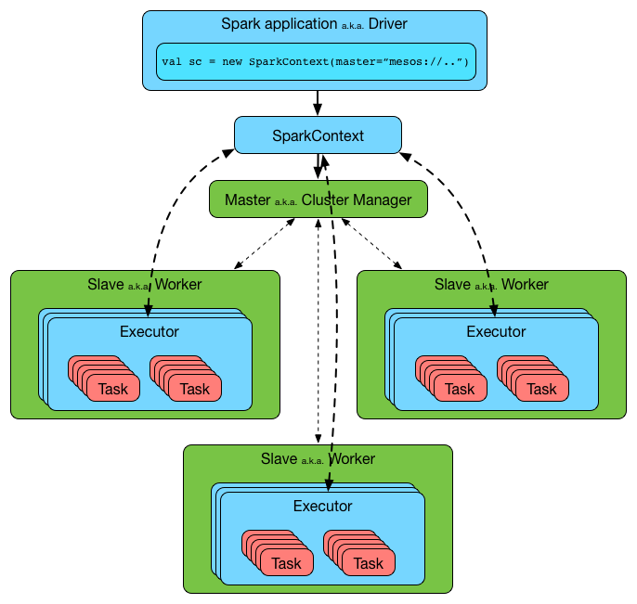
Spark

Slide 40
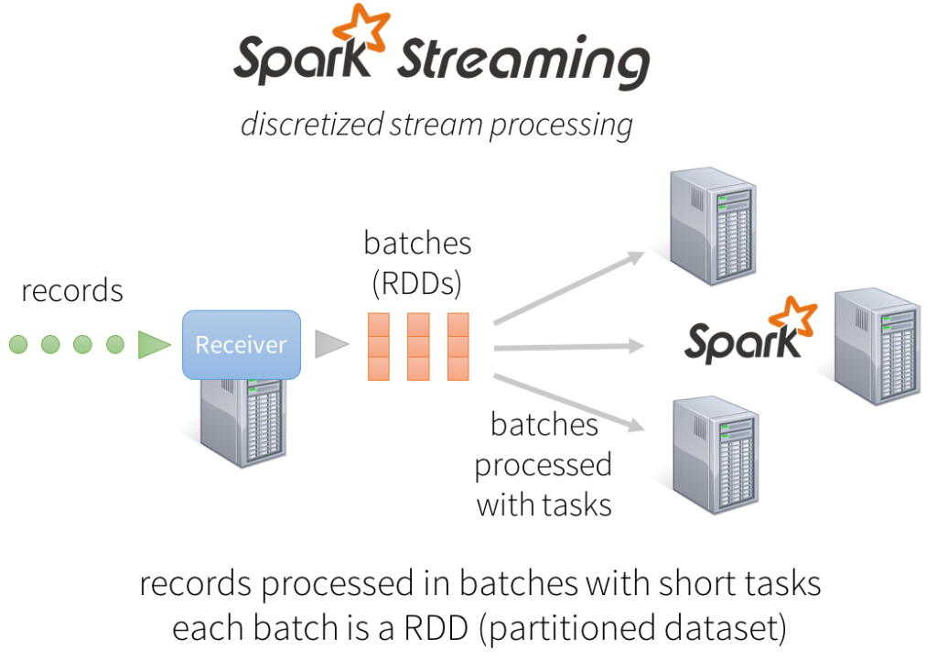

Slide 41
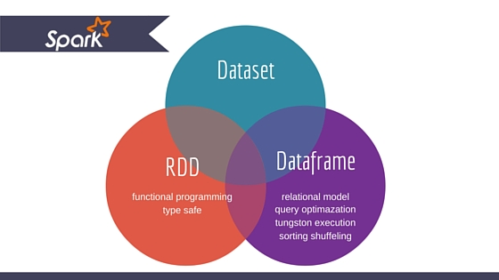
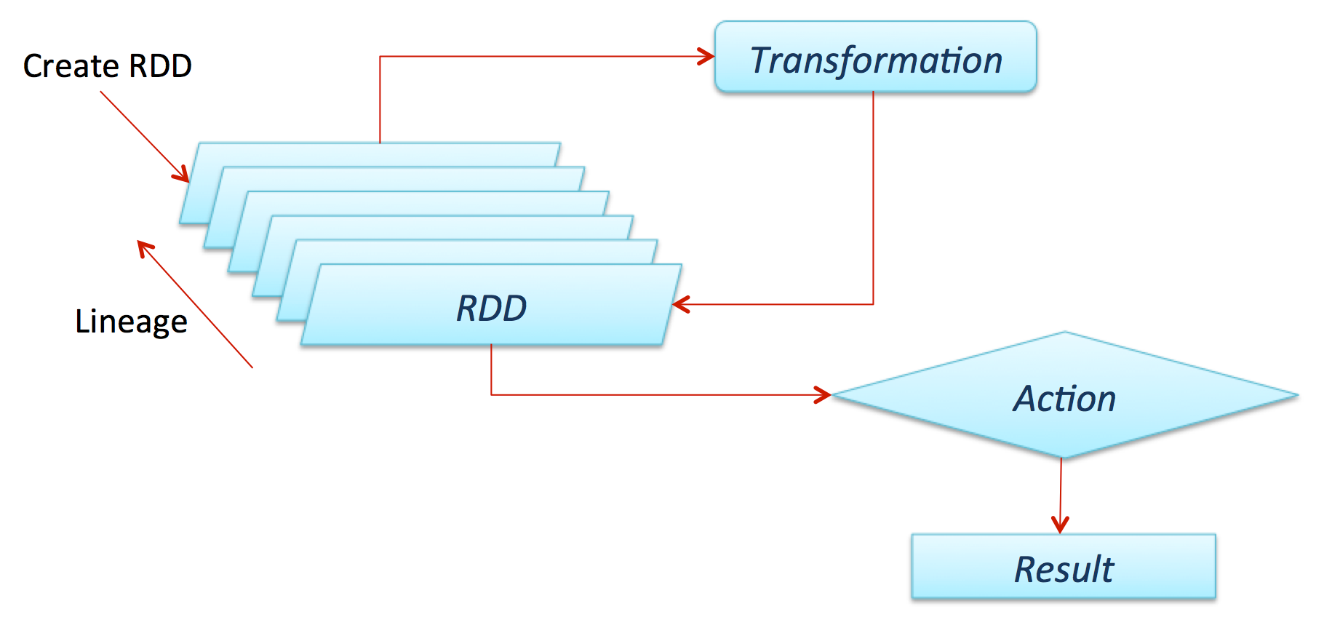
Spark Data

Slide 42

Lambda Architecture

Slide 43

Lambda Architecture

Slide 44
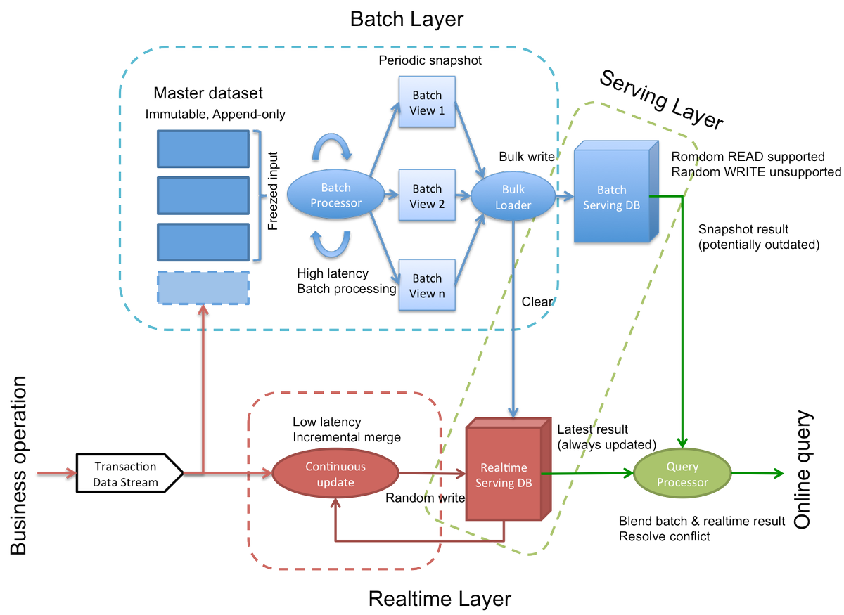

Slide 45
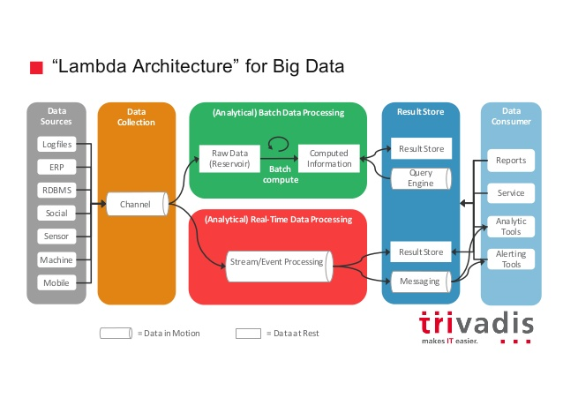

Slide 46

Kappa Architecture

Slide 47
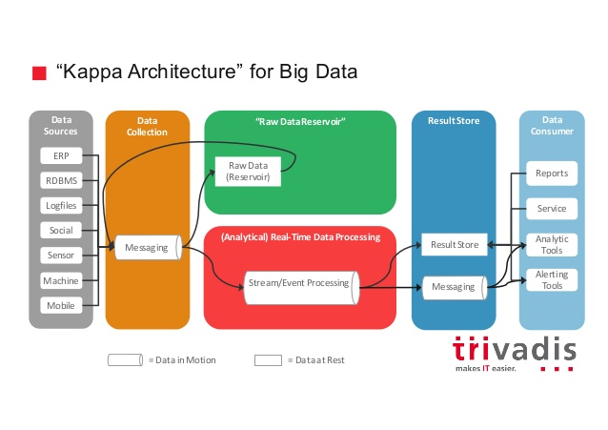

Slide 48

Flume
Notes:
Apache Flume es un sistema distribuido para capturar de forma eficiente, agregar y mover grandes cuantidades de datos log de diferentes orígenes (diferentes servidores) a un repositorio central, simplificando el proceso de recolectar estos datos para almacenarlos en Hadoop y poder analizarlos. Flume y Chukwa son proyectos parecidos, la principal diferencia es que Chukwa está pensado para ser usado en Batch.

Slide 49
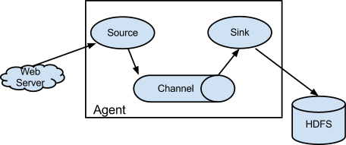
Flume

Slide 50
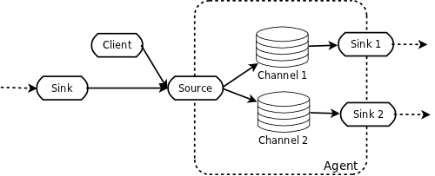
Flume pipeline

Slide 51
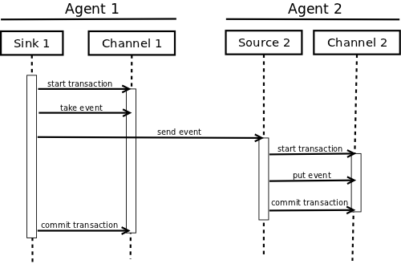
Flume – Agents transaction

Slide 52

Impala

Slide 53
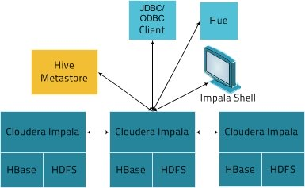
Impala

Slide 54

Cassandra

Slide 55
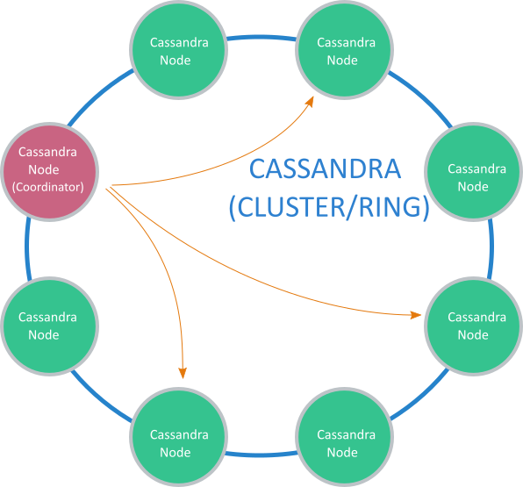
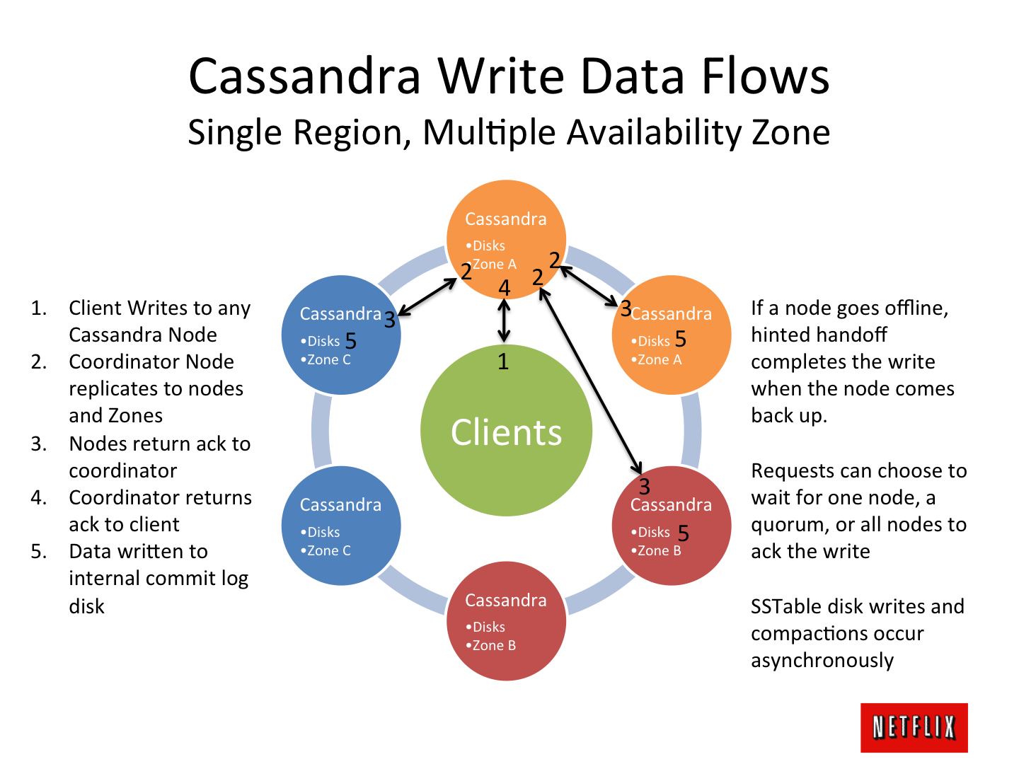

Slide 56
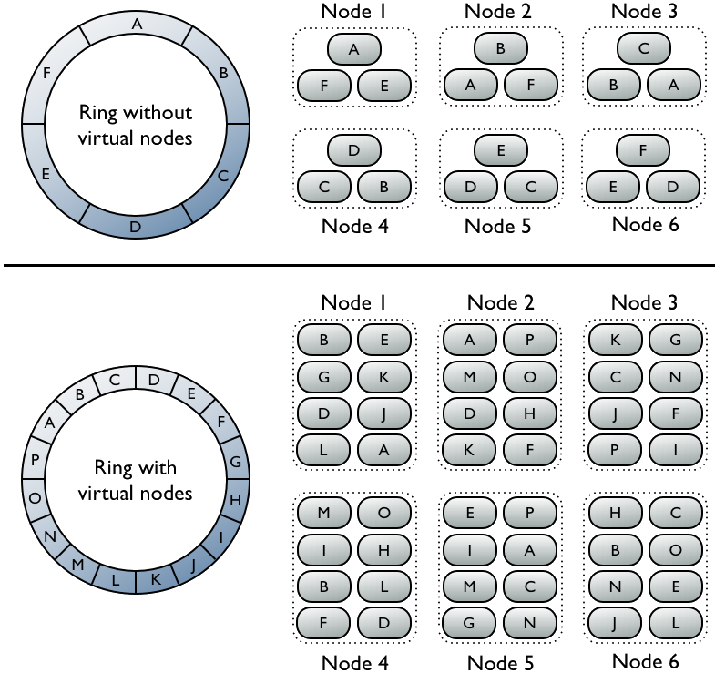

Slide 57

Tez

Slide 58
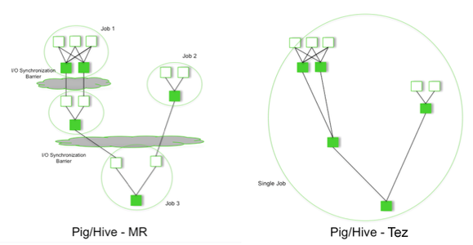
Tez

Slide 59

Mahout
Notes:
Apache Mahout, es un proyecto para crear aprendizaje automático y data mining usando Hadoop. Es decir, Mahout nos puede ayudar a descubrir patrones en grandes datasets. Tiene algoritmos de recomendación, clustering y clasificación.

Slide 60
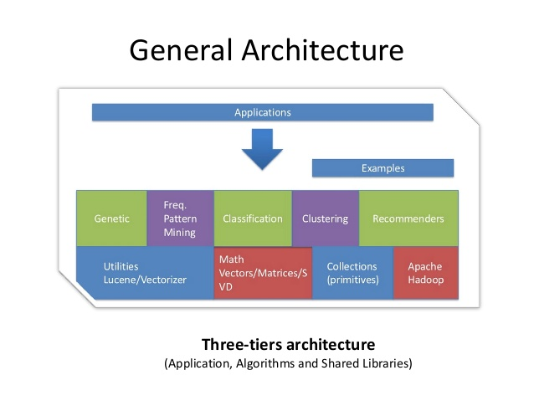
Mahout

Slide 61
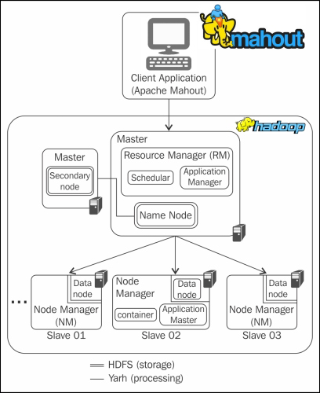

Slide 62

Flink

Slide 63
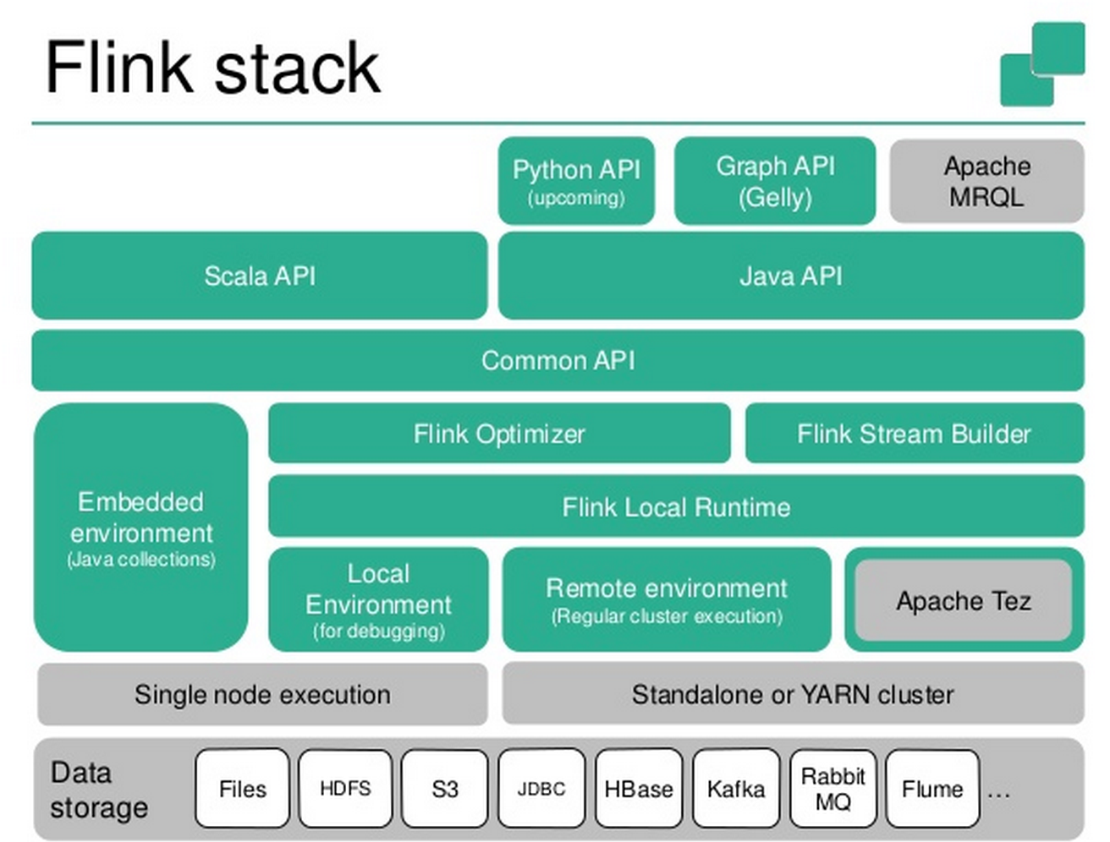

Slide 64
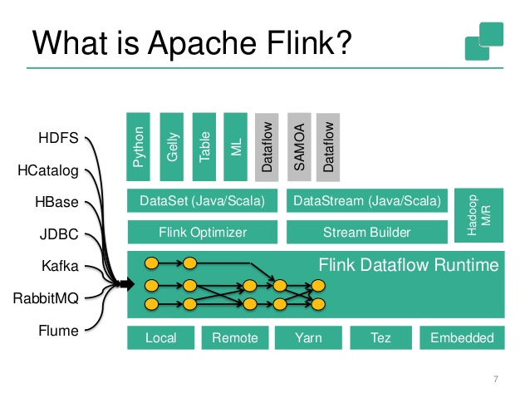

Slide 65
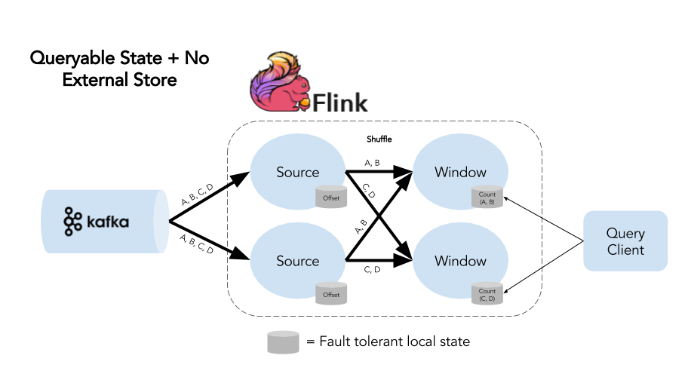
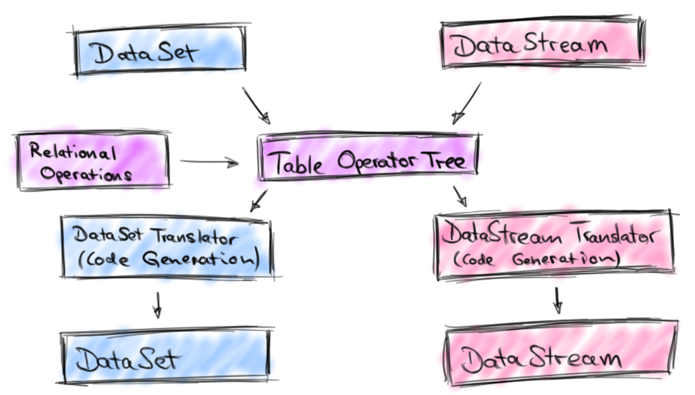

Slide 66
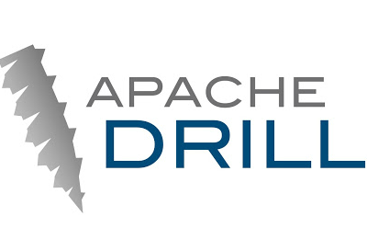
Apache Drill

Slide 67
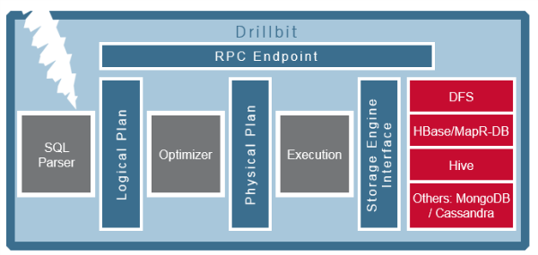
Apache Drill

Slide 68
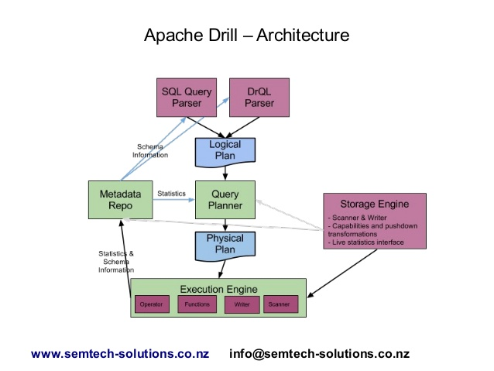
Apache Drill

Slide 69

MongoDB

Slide 70
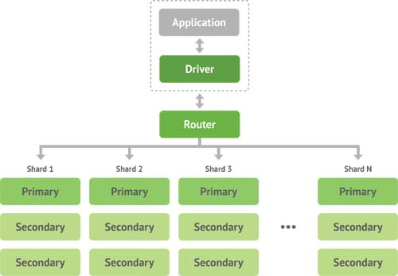
MongoDB

Slide 71

MongoDB

Slide 72

Apache Ambari

Slide 73


Slide 74

Hue

Slide 75


Slide 76

Storm

Slide 77


Slide 78


Slide 79

HBase
Notes:
HBase, se trata de la base de datos de Hadoop. HBase es el componente de Hadoop a usar, cuando se requiere escrituras/lecturas en tiempo real y acceso aleatorio para grandes conjuntos de datos. Es una base de datos orientada a la columna, eso quiere decir que no sigue el esquema relacional. No admite SQL.

Slide 80

HBase

Slide 81

HBase

Slide 82

Hbase Cluster

Slide 83

Zookeeper
Notes:
Zookeeper es un proyecto de Apache que proporciona una infraestructura centralizada y de servicios que permiten la sincronización del cluster. ZooKeeper mantiene objetos comunes que se necesiten en grandes entornos de cluster. Algunos ejemplos de estos objetos son información de la configuración, jerarquía de nombres…

Slide 84


Slide 85

Kafka

Slide 86

Kafka

Slide 87

Oozie

Slide 88


Slide 89

Oozie workflow

Slide 90

Avro
Notes:
Avro, es un sistema de serialización de datos. En los proyectos en Hadoop, suele haber grandes cuantidades de datos, la serialización se usa para procesarlos y almacenar estos datos, de forma que el rendimiento en tiempo sea efectivo. Esta serialización puede ser en texto en plano, JSON, en formato binario. Con Avro podemos almacenar y leer los datos fácilmente desde diferentes lenguajes de programación. Está optimizado para minimizar el espacio en disco necesario para nuestros datos.

Slide 91

Avro
Object container file

Slide 92

Amazon Web Services

Slide 93


Slide 94


